Slide 1

Chapter 11
OBJECT ORIENTED PROGRAMMING

Slide 2
14.1 Managing larger programs
Four basic programming patterns which we use to construct programs:
Sequential code
Conditional code (if statements)
Repetitive code (loops)
Store and reuse (functions)
Also, we explored:
simple variables,
collection data structures like lists, tuples, and dictionaries.
As you build programs, you design data structures and write code to manipulate those data structures mentioned above.

Slide 3
It becomes increasingly important to write code that is easy to understand because programs can be millions of lines long.
If you are working on a million-line program, you are not able to keep the entire program in your mind at the same time.
Best practise is to break large programs into multiple smaller pieces so that you have less to look at when you are:
solving a problem,
fixing a bug,
adding a new feature.

Slide 4
14.2 What is OOP?
Python is an object - oriented programming language.
That means it provides features that support object - oriented programming (OOP).
Object-oriented Programming (OOP) is a programming paradigm that uses objects and classes in programming. It aims to implement real-world entities like inheritance, polymorphisms, encapsulation, etc. in the programming. The main concept of OOPs is to bind the data and the functions that work on that together as a single unit so that no other part of the code can access this data.

Slide 5
Object-oriented programming - was developed as a way to handle the rapidly increasing size and complexity of software systems and to make it easier to modify these large and complex systems over time.
It has its roots in the 1960s, but it wasn’t until the mid 1980s that it became the main programming paradigm used in the creation of new software.
Programming paradigms are a way to classify programming languages based on their features. Languages can be classified into multiple paradigms.

Slide 6
One of the popular approaches to solve a programming problem is by creating objects.
An object contains both data and methods, which are functions that are built into the object and can modify or perform operations on it.
As another way of putting it, objects “know things” and “can do things”:
Objects “know things”: an object holds data.
Objects “can do things”: an object contains code (the methods).

Slide 7
An object has two characteristics:
Attributes
Behavior
Example:
A dog is an object, as it has the following properties:
name, age, color as attributes
barking as behavior
The concept of OOP in Python focuses on creating reusable code. This concept is also known as DRY (Don't Repeat Yourself).

Slide 8
In Python, the concept of OOP follows some basic principles:
Class
Object
Methods
Inheritance
Encapsulation
Polymorphism

Slide 9
14.2.1 Class
Classes provide a means of bundling data and functionality together. Creating a new class creates a new type of object, allowing new instances of that type to be made.
Each class instance can have attributes attached to it for maintaining its state. Class instances can also have methods (defined by its class) for modifying its state.

Slide 10
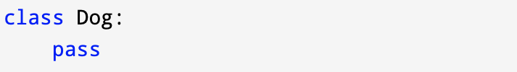
Example:
In the example above we use the class keyword to define empty class dog.
From class, we construct instances. An instance is a specific object created from a particular class.

Slide 11

14.2.2 Object
An object (instance) is an instantiation of a class. When class is defined, only the description for the object is defined. Therefore, no memory or storage is allocated.
Example:
obj is an object of the class Dog().

Slide 12
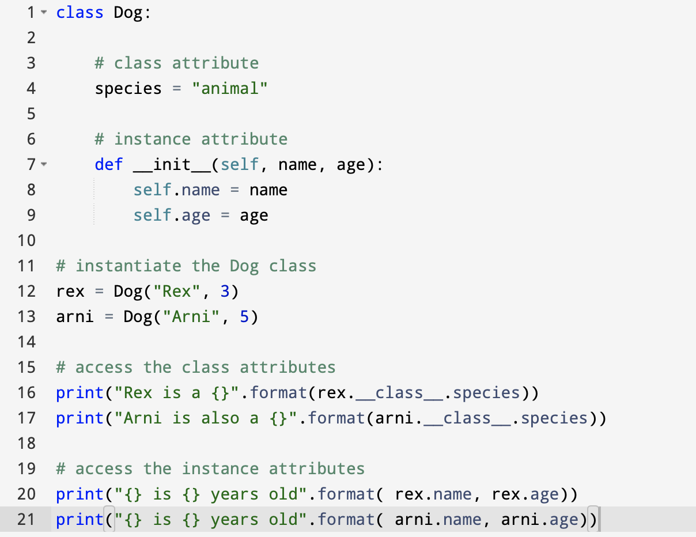
Example: Class and Object in Python

Slide 13
In the above program, we created a class with the name Dog. Then, we define attributes. The attributes are a characteristic of an object.
These attributes are defined inside the __init__ method of the class. It is the initializer method that is first run as soon as the object is created.
Then, we create instances of the Dog class. Here, rex and arni are references (value) to our new objects.
We can access the class attribute using __class__.species.
Class attributes are the same for all instances of a class. Similarly, we access the instance attributes using rex.name and rex.age. However, instance attributes are different for every instance of a class.

Slide 14
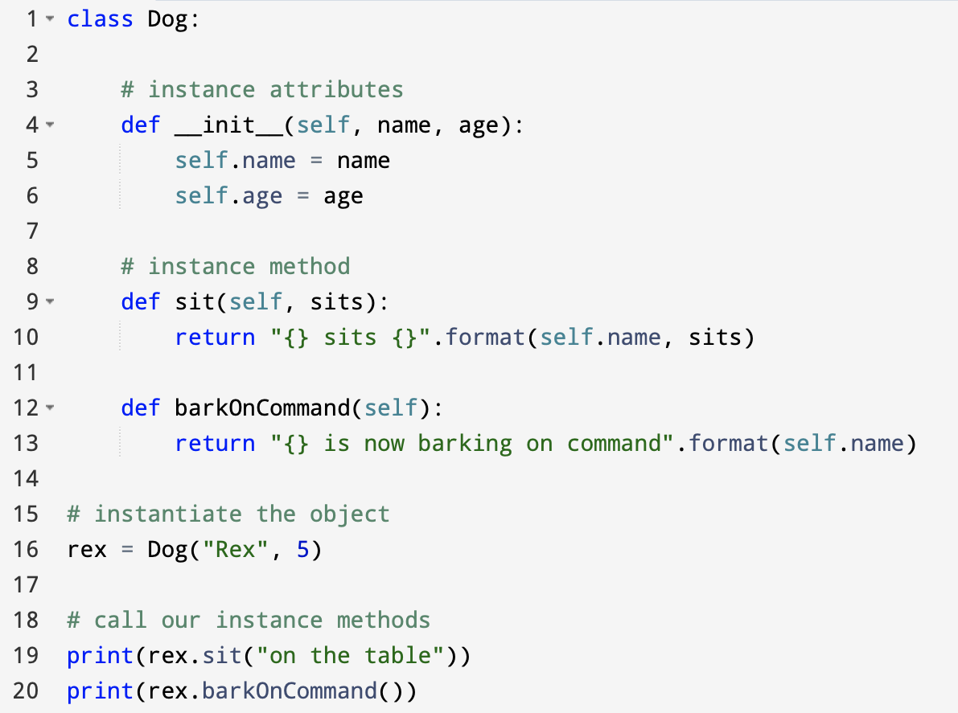
14.2.3 Methods
Methods are functions defined inside the body of a class. They are used to define the behaviors of an object.
Example:

Slide 15
In the example above, we define two methods i.e sit() and barkOnCommand(). These are called instance methods because they are called on an instance object i.e rex.

Slide 16
14.2.4 Inheritance
Inheritance is the capability of one class to derive or inherit the properties from another class.
Parent class is the class being inherited from, also called base class.
Child class is the class that inherits from another class, also called derived class.

Slide 17
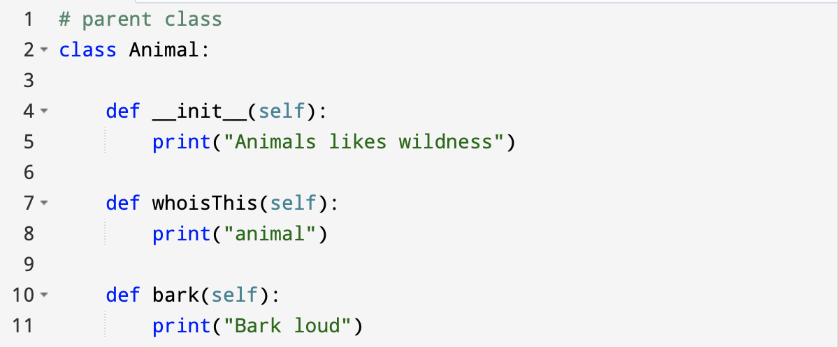
Example:

Slide 18
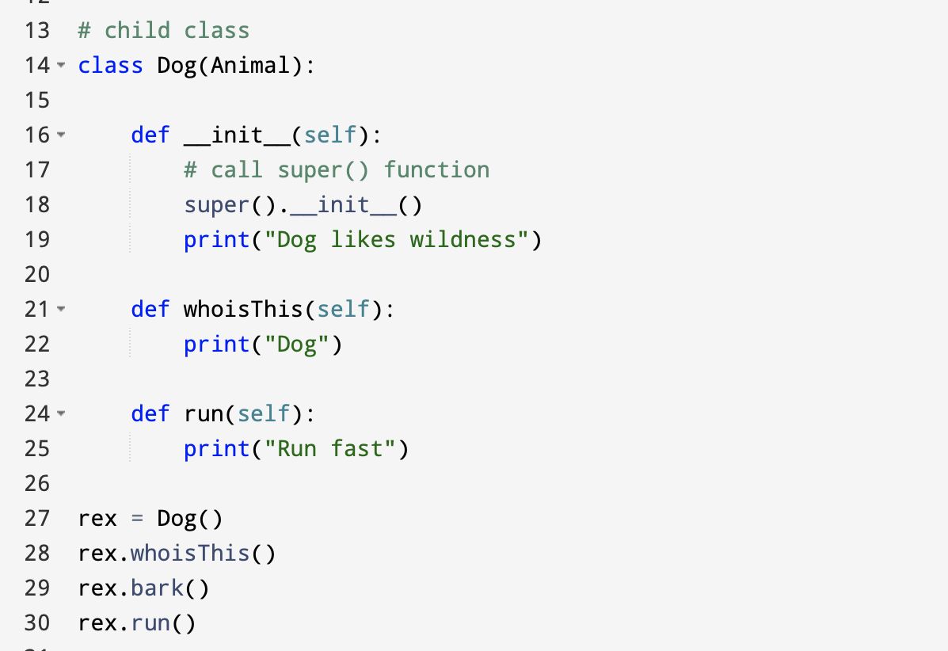

Slide 19
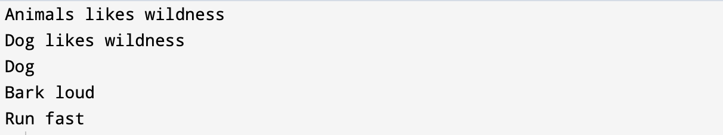
Output:
In the above program, we created two classes i.e. Animal (parent class) and Dog (child class). The child class inherits the functions of parent class. We can see this from the bark() method.
Again, the child class modified the behavior of the parent class. We can see this from the whoisThis() method. Also, we extend the functions of the parent class, by creating a new run() method.
Additionally, we use the super() function inside the __init__() method. This allows us to run the __init__() method of the parent class inside the child class.

Slide 20
14.2.5 Encapsulation
Encapsulation is one of the fundamental concepts in object - oriented programming (OOP).
Using OOP in Python, we can restrict access to methods and variables.
Encapsulation prevents data from direct modification. In Python, we denote private attributes using underscore as the prefix i.e single _ or double __.

Slide 21
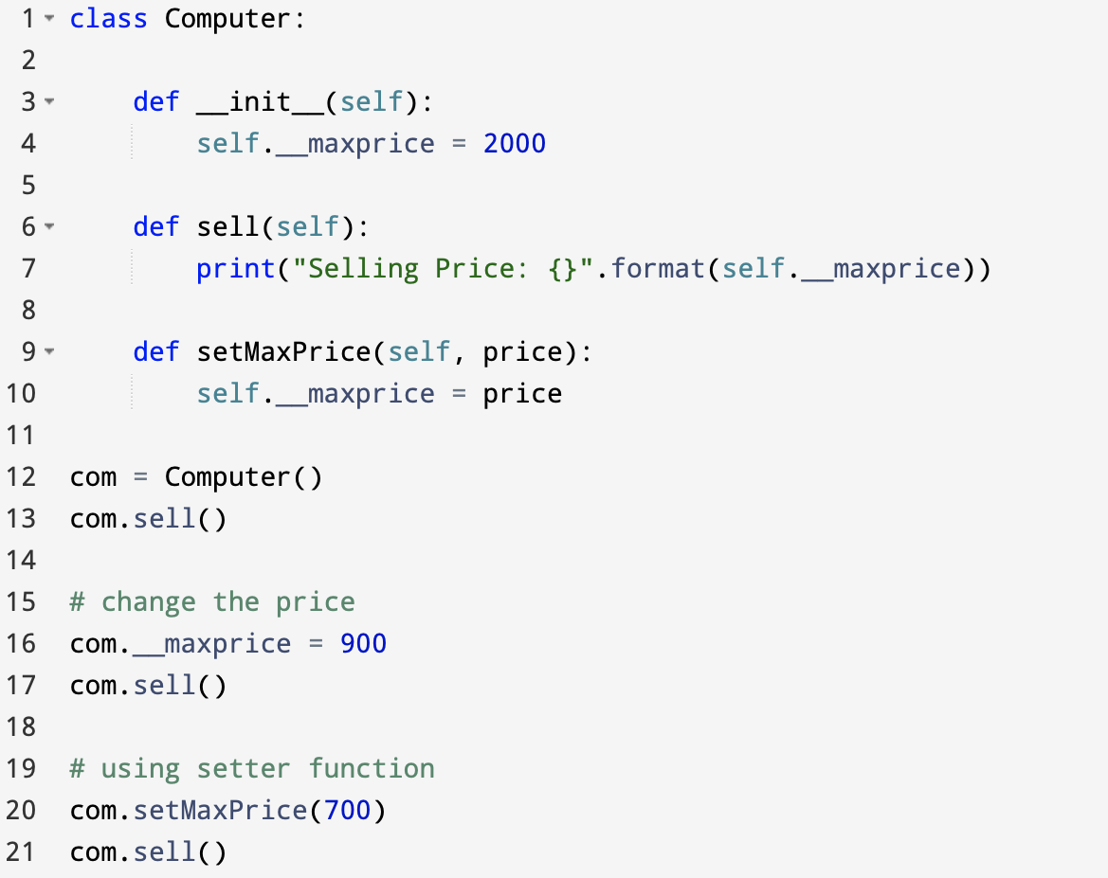
Example:

Slide 22
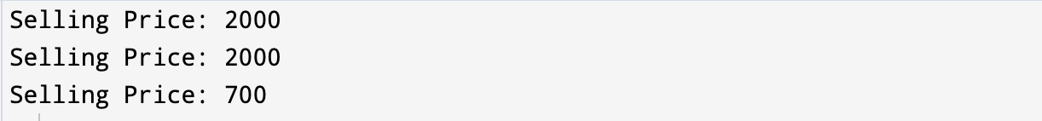
Output:
In the exercise above, we defined a Computer class.
We used __init__() method to store the maximum selling price of Computer (com.__maxprice = 900).
We have tried to modify the value of __maxprice outside of the class. Since __maxprice is a private variable, this modification is not seen on the output.
As shown, to change the value, we have to use a setter function i.e setMaxPrice() which takes price as a parameter.

Slide 23
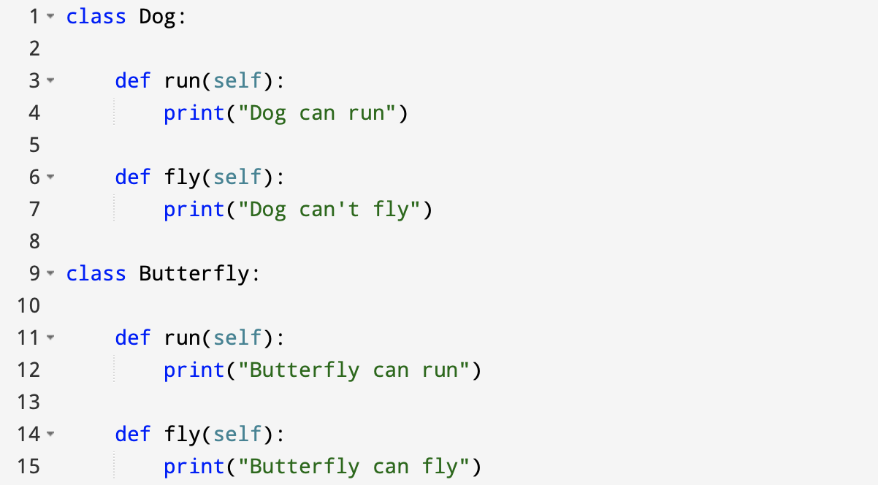
14.2.5 Polymorphism
In programming, polymorphism means the same function name (but different signatures) being used for different types.
Example:

Slide 24
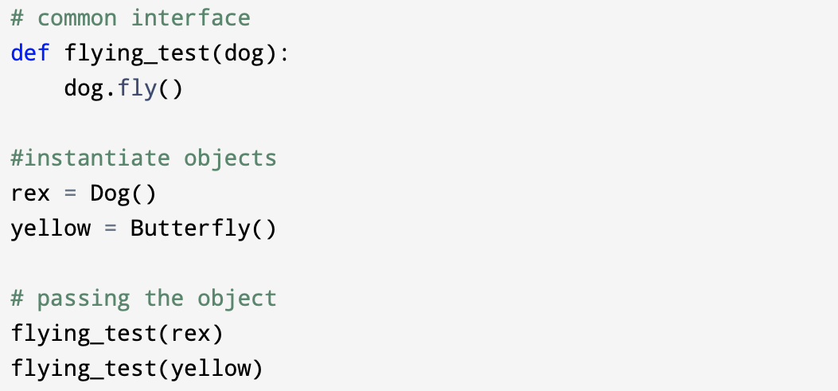

Slide 25
Output:
In the example above, we defined two classes Dog and Butterfly. Each of them have a common fly() method. However, their functions are different.
To use polymorphism, we created a common interface i.e flying_test() function that takes any object and calls the object's fly() method. Thus, when we passed the rex and yellow objects in the flying_test() function, it ran effectively.

Slide 26
14.3 Exercises
Exercise 1:
Create a Circle class and initialize it with radius. Make two instance methods getArea and getCircumference inside this class. Implement the methods.
No need to write test class or main function for this.
Exercise 2:
Create a Temperature class. Make two class/static methods :
convertFahrenheit - It will take Celsius and will convert and print it into Fahrenheit.
convertCelsius - It will take Fahrenheit and will convert it into Celsius.
Write a test class for this one and test it (Look at problem 3 and 4 for example)

Slide 27
Exercise 3:
Create a Student class and initialize it with coursesGrades, name and id number. Make methods to :
Display - It should display the name and id number of the student.
AddCourseGrade – It adds the grades of the courses to the list of courses.
getAverage – it calculates the average (GPA) of the student based on the grades of the student.
No need to write test class or main function for this.
Exercise 4:
Look around your classroom or your bedroom and come up with 3 classes that you see there.
For each class define 3 instance variables.
For each class define 1 static variable.
For each class define an accessor and a mutator for each instance variable.
For each class define 2 instance methods in addition to the accessors and the mutators.
For each class define a constructor which initializes all its instance variables.

Slide 28
Exercise 5:
Write a python program with the following description:
Define a class called MyCustomList.
The class has an instance variable called myList which is a list of integers.
Define the following instance methods for the class:
addItem: It has an input of type int and it adds the number to the list if this number already does not exist in the list. If it exists it will ignore it.
calculateSum: It has no input and will return the sum of all numbers in the list.
calculateMax: it has no input and will return the maximum number of the list.
printList: It has no input but prints the current content of the list to the out.
Remember to define a constructor for this class.
Define another class called Test MyCustomList. This class has a static method called testMyCustomList. This method is used to contain a test scenario for the MyCustomeList.
In another python file, define a main function and use the TestClass to test the MyCustomeList class.

